Slide 1



Company x
Platform
Project
Unleash development velocity & efficiency
THE
PLATFORMERS

Slide 2

AGENDA
Company Goals
Today’s Main Challenges
Suggested Solution
Get to know the technology
Demo
Case Studies
Plan / Next Steps

Slide 3
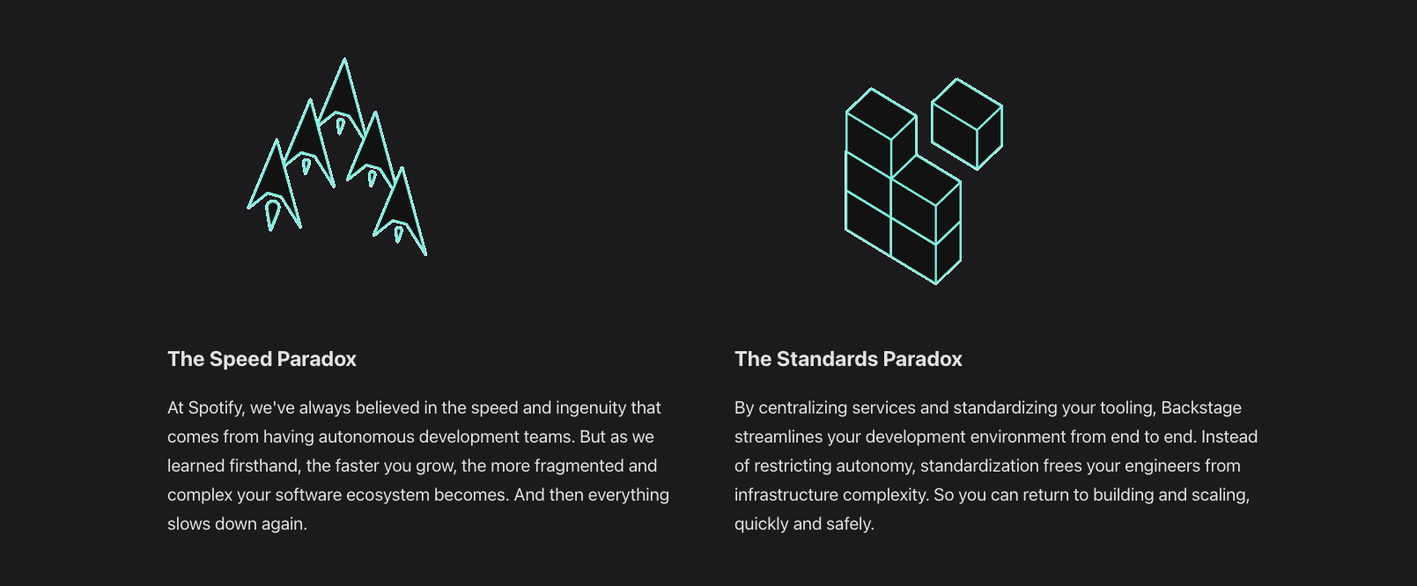

Slide 4



Increase Dev-Velocity
Create more changes in production with less people involved
Company Goals
Global Efficiency
Increase the efficiency of team all around the world
Self-Sufficient Developers
Make the engineers independent and not rely on the infra teams
icons created by the noun project

Slide 5



Migration to the cloud
Migrate to a new technology in an efficient way
Company Goals
(other options)
Reduce DevOps as Bottleneck
DevOps are required of a lot of tasks and slowing delivery
Create Self-Service
Create a modern class engineering organization
icons created by the noun project

Slide 6



Scale Engineering
Grow the engineering organization in 2x next year
Company Goals
(other options)
Streamline Incident Mgmt
Reduce the number / frequency of incidents and their impact
Create Internal Platform
Launch an internal developer platform / services platform
icons created by the noun project

Slide 7



Increase Production Standards
Increase availability, security & production ready standards
Company Goals
(other options)
Launch a Strategic Product
Launch a new product with new requirements that is part of company strategy
Support Reorganization
Support emerging challenge due to reorganization
icons created by the noun project

Slide 8









Main Challenges
Cognitive Load Due to Large Volume of systems
Too Many Systems (which one is the right one)
Duplicate Purpose Systems
Current stack is a distributed patchwork of tools

Slide 9
Main Challenges
Cognitive Load Due to Large Volume of systems
In real life, the answer to a simple question like “what’s the status of my deployment” can be found between 5-15 tabs

Slide 10


Main Challenges
Too Many Duplicate Processes
There are 3-5 tools for deployment, and each one got
multiple paths to deploy

Slide 11
Main Challenges
Documentation is scattered
Multiple Documentation platforms
Different docs platforms
APIs not documented
Service -> Docs hard to discover

Slide 12
Main Challenges
There are no golden paths
There are multiple ways to create applications
There is no “right” / “recommended” way to do common things
Developers can be confused and having trouble to find the right path

Slide 13
Main Challenges
Observability tooling is confusing
blablabla

Slide 14
Main Challenges
There are no automations for main processes
blablabla

Slide 15
Main Challenges
Lack of self-service
bla

Slide 16


Internal Developer Platform
An easy and intuitive way for any developer in the organization to consume services.
Suggested Solution
Single Pane of Glass
Consolidation of all the organization’s tools, APIs, frameworks, languages, etc.
Ready-Made Templates
Make the engineers independent rather than rely on the infra teams.
icons created by the noun project

Slide 17

Self-Sufficient Developers
Make the engineers independent and not rely on the infra teams
Expected Outcomes
Accelerated Delivery
Delivery much more code and more frequent to production
Standard Enforcement
Pave golden paths for developers that ensure the correct path is the easiest path
icons created by the noun project

Slide 18
The
Technology

Slide 19

Demo!

Slide 20

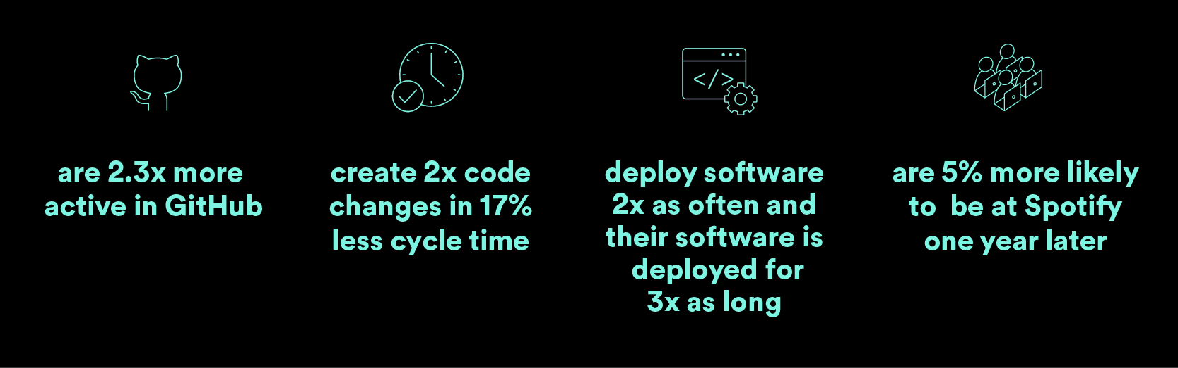
Case Studies - Spotify

Slide 21

Case Studies - Expedia
Impact
Ship on Day 1
Reduce context switching
Technical documentation reach
4-min average per app creation/onboarding with ~95% on the first try
7,000+ components created or onboarded
4000+ unique users using Backstage for ~20 min on average a day.
15%+ of internal developer tools are integrated within Backstage, reducing the amount of context-switching needed
50,000+ average monthly TechDoc views
500+ services tied with TechDocs
Adoption
Notes:
https://backstage.io/blog/2023/08/17/expedia-proof-of-value-metrics-2/

Slide 22

Case Studies -
Delivery Acceleration
Save $$$
Standardized Deployment
Projects ship weekly instead of quarterly
8-12 Weeks saved for 25 teams, equivalent to 250,000$ per team.
Over 5M$ saved annually year over year since 2022
40 approved templates
for deploying applications
Notes:
https://backstage.io/blog/2023/08/17/expedia-proof-of-value-metrics-2/

Slide 23
POC
1
Create a POV deployment + single flow
ETA: 2-4 weeks
Plan
&
Next Steps
2
Beta Onboarding
Onboard beta teams for feedback
ETA: 4-6 weeks
3
Full Onboarding
Onboard x teams
ETA: 6-10 weeks
4
Continuous Optimization
Q review & optimize more processes
ETA: 10+ weeks
icons created by the noun project

Slide 24
Thank You ;-)

